Slide 1

Rockbuster: Establishing Our Baseline for Global Profitability and Growth
A Data Deep Dive into Film & Customer Operations

Slide 2

Presentation Agenda
Context on data analysis
Customer Base Overview
Film Inventory and Operations
Rockbuster's Global Footprint
Conclusion
Notes:
We will begin by reviewing Rockbuster's current business model, followed by an analysis of market trends and challenges. Then, we'll discuss innovative growth strategies and operational improvements. Finally, we'll outline the vision for Rockbuster's future development and sustainability.

Slide 3
The Rockbuster Blueprint: Validating Efficiency and Pinpointing Global Opportunities
The foundation of any successful global business is a standardized operational model and a clear view of customer value. We initiated this deep dive to establish a baseline operational blueprint and secure our path to future growth.
Validate Core Efficiency: We must confirm that our pricing, rental duration, and inventory cost structures are predictable and standardized across the entire global enterprise.
Identify Leveraged Opportunities: We must pinpoint unexpected market performance, customer anomalies, and areas where immediate management action can maximize our return on investment (ROI).

Slide 4
Customer Base Overview
Notes:
Understanding Rockbuster's core services and operations is key to identifying opportunities for innovation. This section covers customer experience, store logistics, and competitive advantages in the rental market.

Slide 5


Total Active Customers: 599.
A significant strength is that 100% of our customer base is marked as active, indicating a high-quality starting list.
Store 1 Dominance
Store 1 is the higher driver of this customer base, showing a better response to our targeted campaign and Valentine’s event.
We should analyze the factors (geographic, operational, or marketing) behind this dominance to replicate its success across the entire Rockbuster network.
Mass Acquisition Event
Mass Acquisition Event: 2006-02-14 (Valentine's Day). The entire customer base was acquired on a single date, suggesting a highly effective, one-time targeted campaign. This provides a clear start-date for all analysis.
Notes:
--- Rockbuster offers a curated selection of movie rentals with personalized customer service. The company focuses on creating an engaging and convenient rental experience through knowledgeable staff and user-friendly interfaces. Image source: Microsoft 365 content library

Slide 6
Film Inventory and Operations
Notes:
We explore strategic initiatives aimed at expanding Rockbuster’s market share, including digital rentals, loyalty programs, and partnerships.

Slide 7
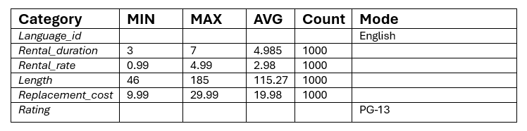
Standardized Rental Rates: The average rental price of $2.98 aligns with the median, confirming a stable and predictable pricing structure. We should review films priced at the minimum ($0.99) and maximum ($4.99) to assess discounting or premium opportunities.
Standard Rental Duration: A consistent 5-day rental duration is the operational standard, which is critical for predictable inventory turnover and cash flow forecasting.
Inventory Profile: The average movie is just under 2 hours, PG-13 rated, and English-only, confirming a heavy focus on the family/teen core market segment.
Replacement Cost Benchmark: The average replacement cost of $19.98 is the benchmark figure for setting replacement fees and forecasting future inventory investment.

Slide 8
Rockbuster's Global Footprint
Notes:
Optimizing internal processes boosts Rockbuster’s productivity and service quality. This section focuses on inventory, data use, and staff development.

Slide 9
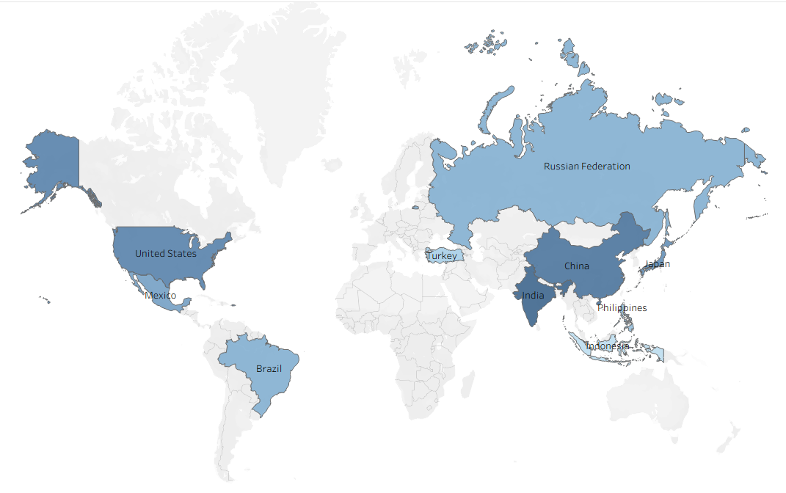
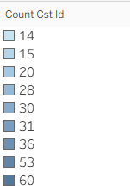
Global Market Penetration
Focus: Tiered structure and the anomaly of missing major markets.
Tier 1 (High Potential): India, China. These markets are our volume leaders, with a combined customer base that significantly outpaces the next tier. They are key to volume growth.
Tier 2 (Solid Presence): United States, Japan, Mexico. These countries provide a strong, stable presence that should be the focus of near-term stabilization and moderate growth efforts.
Tier 3 (Emerging/Niche): Brazil, Russian Federation, Philippines, Turkey, Indonesia.
Global Reach: Rockbuster has a surprisingly diverse global customer base, reaching across four continents (Asia, North America, South America, Europe).
Absence of Major European Markets: The complete absence of major European economies (UK, Germany, France) in the Top 10 is a critical market gap and suggests a significant untapped global opportunity.

Slide 10
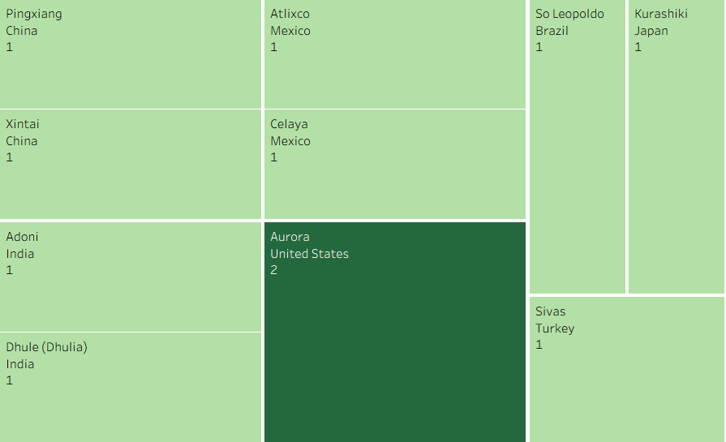
Low Concentration and Scattered Customer Penetration
Alarming Anomaly: Scattered Penetration. The most striking finding is the severe lack of customer concentration—the top 10 cities within our top 10 countries each have a maximum of only 1 or 2 customers.
Key Takeaway: While we are geographically diverse, we lack the deep, profitable customer clusters necessary for efficient local marketing and logistics. Our penetration is wide but extremely shallow.
Actionable Insight: The query for "Top 10 Cities" may be too restrictive. However, this finding strongly suggests a potential data capture/query limitation or a high operational inefficiency due to a severely fragmented customer base. We must resolve this data clarity issue immediately.
Notes:
--- Introducing online rentals and streaming services can broaden Rockbuster’s reach and cater to evolving customer preferences. Image source: Microsoft 365 content library

Slide 11
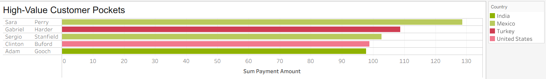
High-Value Customer Pockets
High-Value Pockets: Mexico. Ranked 5th by volume (30 customers) but is disproportionately represented in the Top 5 revenue-generating accounts. This confirms Mexico is a high-value market where we should focus upsell and retention efforts, regardless of overall volume.
The Volume-Revenue Disconnect: India (1st in volume) and China (2nd in volume) are significantly underperforming in revenue per customer. This suggests most of their customers are low-value/low-frequency renters. Our volume leaders are not our profit leaders.
Actionable Target: The highest-spending customers (> $100) are the most critical to the business. We must isolate their traits and behaviors to develop targeted retention and upselling campaigns.
Notes:
--- Leveraging technology to track inventory in real-time helps reduce shortages and overstock, improving customer satisfaction and cost control. Image source: Microsoft 365 content library

Slide 12
Conclusion
Operational Blueprint
Insights:
We have a standardized and predictable operational base (5-day duration, $2.98 avg. rental, PG-13 inventory).
Recommendations: Leverage the standardization to optimize logistics and marketing globally.
Customer Base
Insights:
The current customer base is the result of a single, effective mass-acquisition event focused on Store 1.
Recommendations:
Investigate Store 1's success to create a replicable acquisition playbook for other stores.
Global Markets
Insights:
We have shallow penetration across many countries and a critical absence in major European economies.
Recommendations:
Target European expansion and shift focus in volume-leading markets (India/China) from volume to value.
Profitability
Insights:
There is a severe disconnect between customer volume and revenue/profitability (Mexico vs. India/China).
Recommendations:
Prioritize high-value customers and launch programs to convert low-value renters in volume-leading countries into more profitable customers.
Notes:
Rockbuster’s success hinges on adapting to market changes through innovation, operational excellence, and customer-focused strategies. By embracing these approaches, Rockbuster can thrive in the evolving entertainment landscape.

Slide 13
Questions?
You can also follow up through ben@rockbuster.com

